Slide 1
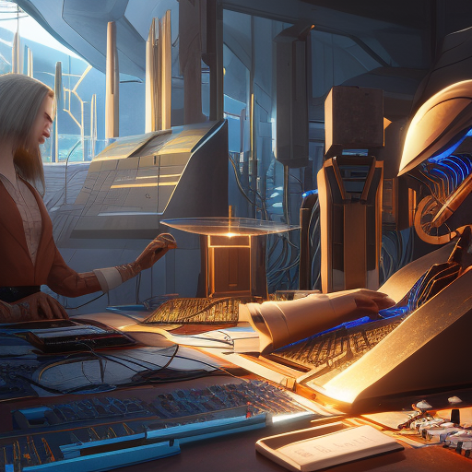
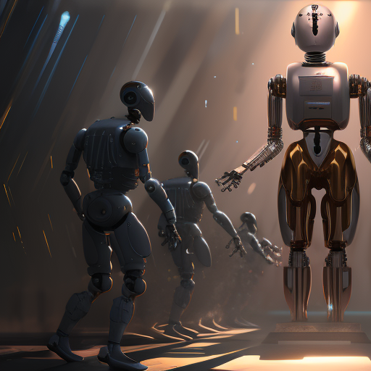

Software Engineering
WEEK 1
ENGR. Muhammad UMER HAROON

Slide 2

Course Content
Nature of Software, Overview of Software Engineering, Professional software development, Software engineering practice, Software process structure, Software process models, Agile software Development, Agile process models, Agile development techniques, Requirements engineering process, Functional and non-functional requirements, Context models, Interaction models, Structural models, behavioral models, model driven engineering, Architectural design, Design and implementation, UML diagrams, Design patterns, Software testing and quality assurance, Software evolution, Project management and project planning, configuration management, Software Process improvement.

Slide 3

WEEK 1

Slide 4
Engineering
-- Application of systematic, disciplined, quantifiable approach to some process

Slide 5
Software
Computer programs, procedures, and possibly associated documentation and data pertaining to the operation of a computer system
The software is instruction or computer program that when executed provide desired features, function, and performance.

Slide 6
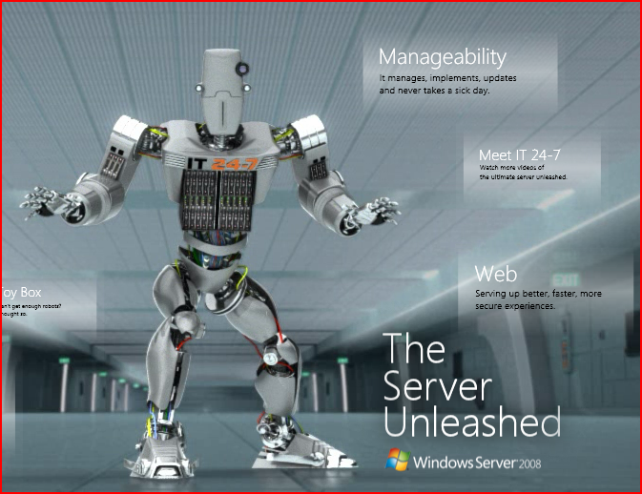
What is Software?
software is engineered
software doesn’t wear out
software is complex

Slide 7
Hardware vs. Software
Hardware
Manufactured
Wears out
Built using components
Software
Developed/Engineered
Deteriorates
Custom built

Slide 8
SOFTWARE CRISIS
The notion of software engineering was first proposed in 1968 at a conference held to discuss what was then called the software crisis (Naur and Randell 1969).
It became clear that individual approaches to program development did not scale up to large and complex software systems. These were unreliable, cost more than expected, and were delivered late.
Throughout the 1970s and 1980s, a variety of new software engineering techniques and methods were developed, such as structured programming, information hiding, and object-oriented development. Tools and standard notations were developed which are the basis of today’s software engineering.

Slide 9
Frequently asked questions about software engineering
Question | Answer
What is software? | Computer programs and associated documentation. Software products may be developed for a particular customer or may be developed for a general market.
What are the attributes of good software? | Good software should deliver the required functionality and performance to the user and should be maintainable, dependable and usable.
What is software engineering? | Software engineering is an engineering discipline that is concerned with all aspects of software production.
What are the fundamental software engineering activities? | Software specification, software development, software validation and software evolution.
What is the difference between software engineering and computer science? | Computer science focuses on theory and fundamentals; software engineering is concerned with the practicalities of developing and delivering useful software.
What is the difference between software engineering and system engineering? | System engineering is concerned with all aspects of computer-based systems development including hardware, software and process engineering. Software engineering is part of this more general process.

Slide 10
Software Engineering
-- The application of systematic, disciplined, quantifiable approaches to software development, operation and maintenance.*
* - IEEE Standard 610.12-1990, IEEE Standard Glossary of Software Engineering Terminology, IEEE Standards Collection Software Engineering, IEEE (1997).

Slide 11
Changing Nature Of Software
Seven broad categories of computer software present continuing challenges for software engineers.

Slide 12
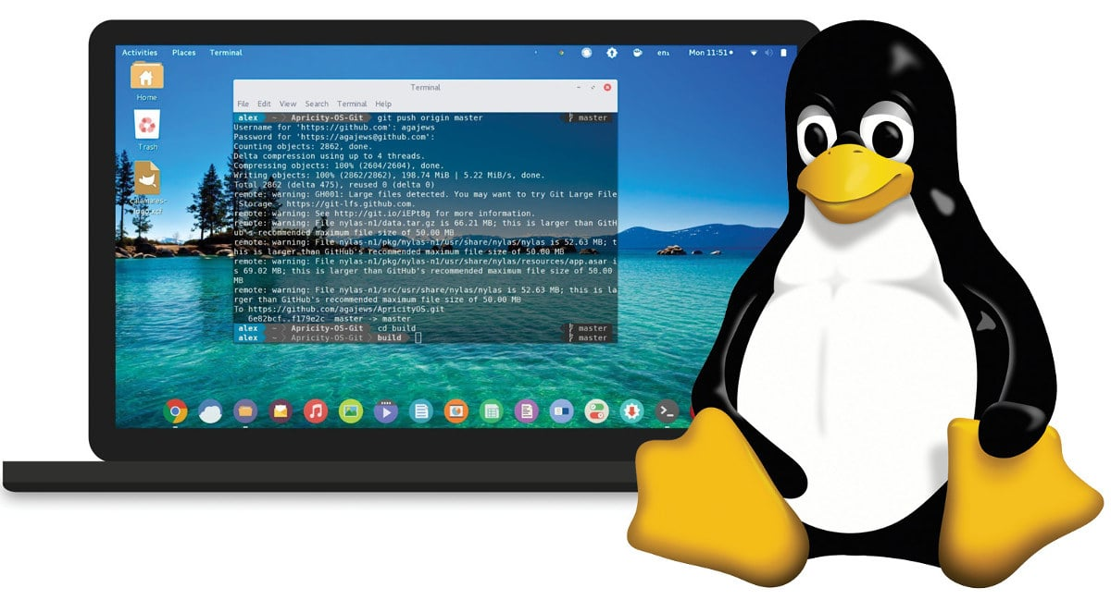
System Software:
System software is a collection of programs which are written to service other programs. Some system software processes complex but determinate, information structures. Other system application process largely indeterminate data. Sometimes when, the system software area is characterized by the heavy interaction with computer hardware that requires scheduling, resource sharing, and sophisticated process management.
1

Slide 13
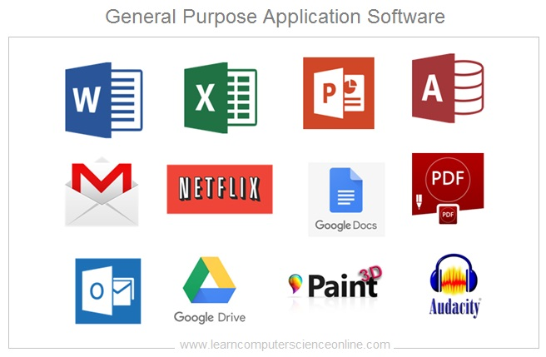
Application Software
Application software is defined as programs that solve a specific business need. Application in this area process business or technical data in a way that facilitates business operation or management technical decision making. In addition to convention data processing application, application software is used to control business function in real time
2

Slide 14
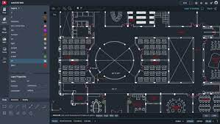
Engineering and Scientific Software:
This software is used to facilitate the engineering function and task. however modern application within the engineering and scientific area are moving away from the conventional numerical algorithms. Computer-aided design, system simulation, and other interactive applications have begun to take a real-time and even system software characteristic.
3

Slide 15
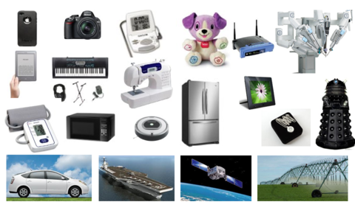
Embedded Software
Embedded software resides within the system or product and is used to implement and control feature and function for the end-user and for the system itself. Embedded software can perform the limited and esoteric function or provided significant function and control capability.
4

Slide 16
Product-line Software
Designed to provide a specific capability for use by many different customers, product line software can focus on the limited and esoteric marketplace or address the mass consumer market.
5
Notes:
Example : automotive software ,
Maps related software

Slide 17
Web Application:
It is a client-server computer program which the client runs on the web browser. In their simplest form, Web apps can be little more than a set of linked hypertext files that present information using text and limited graphics. However, as e-commerce and B2B application grow in importance. Web apps are evolving into a sophisticate computing environment that not only provides a standalone feature, computing function, and content to the end user.
6

Slide 18
Artificial Intelligence Software
Artificial intelligence software makes use of a nonnumerical algorithm to solve a complex problem that is not amenable to computation or straightforward analysis. Application within this area includes robotics, expert system, pattern recognition, artificial neural network, theorem proving and game playing.
7

Slide 19
SOFTWARE ENGINEERING FUNDAMENTALS
Some fundamental principles apply to all types of software system, irrespective of the development techniques used:
Systems should be developed using a managed and understood development process. Of course, different processes are used for different types of software.
Dependability and performance are important for all types of system.
Understanding and managing the software specification and requirements (what the software should do) are important.
Where appropriate, you should reuse software that has already been developed rather than write new software.

Slide 20
Case studies

Slide 21

Case studies
A personal insulin pump
An embedded system in an insulin pump used by diabetics to maintain blood glucose control.
A mental health case patient management system
Mentcare. A system used to maintain records of people receiving care for mental health problems.
A wilderness weather station
A data collection system that collects data about weather conditions in remote areas.

Slide 22
Insulin pump control system
Collects data from a blood sugar sensor and calculates the amount of insulin required to be injected.
Calculation based on the rate of change of blood sugar levels.
Sends signals to a micro-pump to deliver the correct dose of insulin.
Safety-critical system as low blood sugars can lead to brain malfunctioning, coma and death; high-blood sugar levels have long-term consequences such as eye and kidney damage.

Slide 23
Insulin pump hardware architecture

Slide 24
Activity model of the insulin pump

Slide 25
Essential high-level requirements
The system shall be available to deliver insulin when required.
The system shall perform reliably and deliver the correct amount of insulin to counteract the current level of blood sugar.
The system must therefore be designed and implemented to ensure that the system always meets these requirements.

Slide 26
Mentcare: A patient information system for mental health care
A patient information system to support mental health care is a medical information system that maintains information about patients suffering from mental health problems and the treatments that they have received.
Most mental health patients do not require dedicated hospital treatment but need to attend specialist clinics regularly where they can meet a doctor who has detailed knowledge of their problems.
To make it easier for patients to attend, these clinics are not just run in hospitals. They may also be held in local medical practices or community centres.

Slide 27
Mentcare
Mentcare is an information system that is intended for use in clinics.
It makes use of a centralized database of patient information but has also been designed to run on a PC, so that it may be accessed and used from sites that do not have network connectivity.
When the local systems have network access, they use patient information in the database but they can download and use local copies of patient records when they are disconnected.

Slide 28
Mentcare goals
To generate management information that allows health service managers to assess performance against local and government targets.
To provide medical staff with timely information to support the treatment of patients.

Slide 29
The organization of the Mentcare system

Slide 30
Key features of the Mentcare system
Individual care management
Clinicians can create records for patients, edit the information in the system, view patient history, etc. The system supports data summaries so that doctors can quickly learn about the key problems and treatments that have been prescribed.
Patient monitoring
The system monitors the records of patients that are involved in treatment and issues warnings if possible problems are detected.
Administrative reporting
The system generates monthly management reports showing the number of patients treated at each clinic, the number of patients who have entered and left the care system, number of patients sectioned, the drugs prescribed and their costs, etc.

Slide 31
Mentcare system concerns
Privacy
It is essential that patient information is confidential and is never disclosed to anyone apart from authorised medical staff and the patient themselves.
Safety
Some mental illnesses cause patients to become suicidal or a danger to other people. Wherever possible, the system should warn medical staff about potentially suicidal or dangerous patients.
The system must be available when needed otherwise safety may be compromised and it may be impossible to prescribe the correct medication to patients.

Slide 32
Wilderness weather station
The government of a country with large areas of wilderness decides to deploy several hundred weather stations in remote areas.
Weather stations collect data from a set of instruments that measure temperature and pressure, sunshine, rainfall, wind speed and wind direction.
The weather station includes a number of instruments that measure weather parameters such as the wind speed and direction, the ground and air temperatures, the barometric pressure and the rainfall over a 24-hour period. Each of these instruments is controlled by a software system that takes parameter readings periodically and manages the data collected from the instruments.

Slide 33
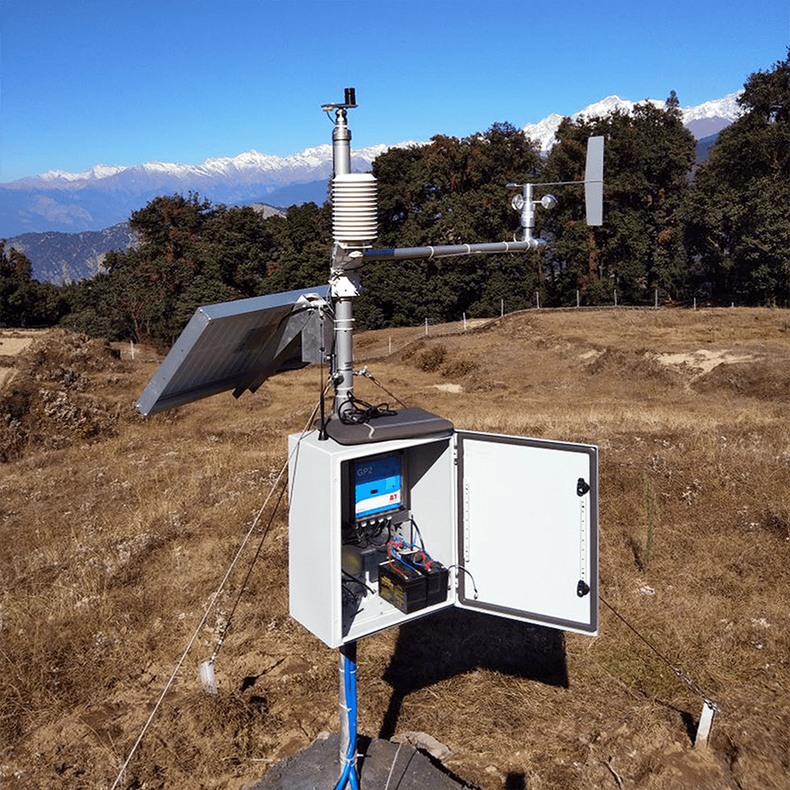
The weather station’s environment

Slide 34
Weather information system
The weather station system
This is responsible for collecting weather data, carrying out some initial data processing and transmitting it to the data management system.
The data management and archiving system
This system collects the data from all of the wilderness weather stations, carries out data processing and analysis and archives the data.
The station maintenance system
This system can communicate by satellite with all wilderness weather stations to monitor the health of these systems and provide reports of problems.

Slide 35
Additional software functionality
Monitor the instruments, power and communication hardware and report faults to the management system.
Manage the system power, ensuring that batteries are charged whenever the environmental conditions permit but also that generators are shut down in potentially damaging weather conditions, such as high wind.
Support dynamic reconfiguration where parts of the software are replaced with new versions and where backup instruments are switched into the system in the event of system failure.

Slide 36

First Week Summary
Course content
SE ?
SW vs HW ?
CRISIS ?
Some Basic Questions ?
Changing Nature of Software ?
Software Fundamentals
Case Studies ?
Here is what we learned

Slide 37
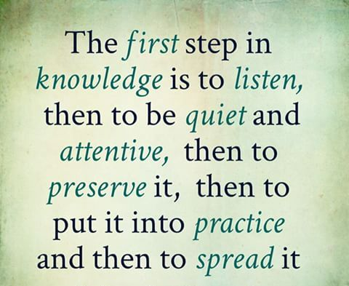
Thank You!

